Slide 1
Online bug detection engine for java programs
徐昊，季尚松，胡超

Slide 2
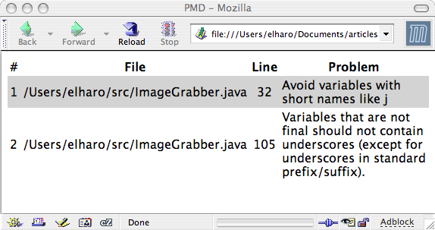

Goal:
Create a tool.
Provide a interface.
Merge the result.

Slide 3
I t can…
Two modes:
Single file & Project
Compile file at background.
Provide own space.
Integrate FindBugs & PMD on website.
Merge the output.

Slide 4
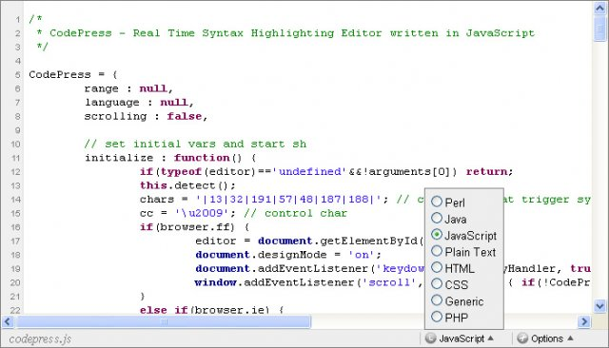
How:
TextArea and upload file.
Install JDK at Server.
Build user system.
JSP && Servlet.
XML Parser.

Slide 5
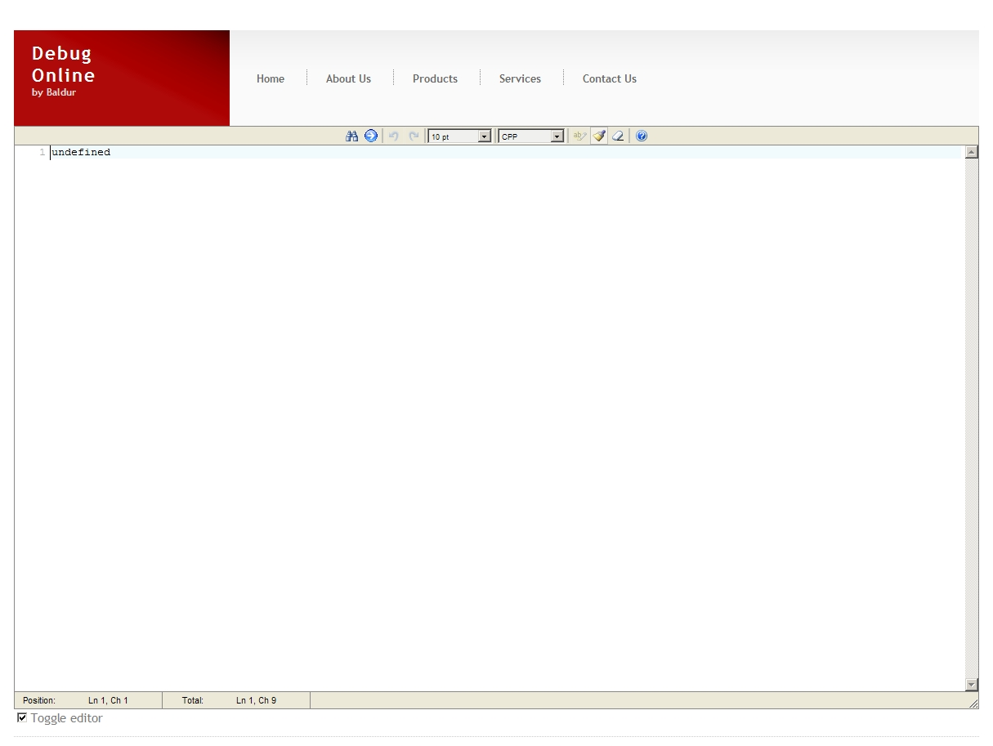

Slide 6
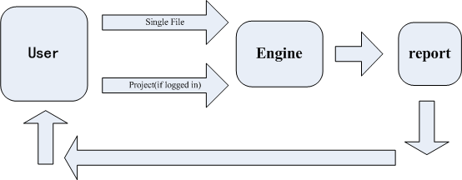
Outside the engine

Slide 7
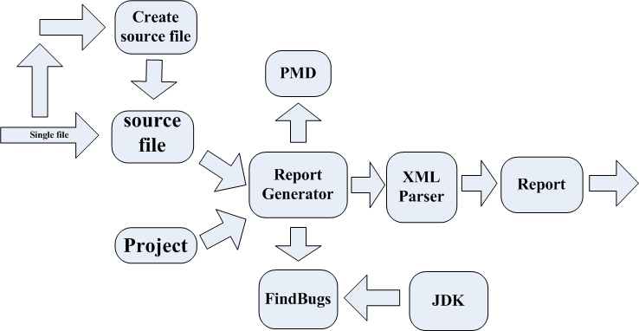
Inside the Engine

Slide 8
Q&A

Slide 9
Thanks

